Slide 1


American Community Survey(ACS) Data extraction through Online Platforms(IPums, data.census.gov)

Slide 2
CCSS Research Support Code of Conduct
The Cornell Center for Social Sciences provides a welcoming environment for everyone embracing all backgrounds or identities. All instructors and attendees agree to abide by our community norms. We encourage the following behaviors in our workshops:
Respect differing viewpoints and ideas
Share your own perspectives and ask any questions
Accept constructive criticism
Use welcoming and inclusive language
Show courtesy and respect for all instructors and attendees
If you believe that an instructor or attendee has violated the code of conduct, please report the violation to CCSS-ResearchSupport@cornell.edu. We take all reported incidents seriously.

Slide 3
Land Acknowledgement
Cornell University is located on the traditional homelands of the Gayogo̱ hó꞉nǫ' (the Cayuga Nation). The Gayogo̱ hó꞉nǫ' are members of the Haudenosaunee Confederacy, an alliance of six sovereign Nations with a historic and contemporary presence on this land. The Confederacy precedes the establishment of Cornell University, New York state, and the United States of America. We acknowledge the painful history of Gayogo̱ hó꞉nǫ' dispossession, and honor the ongoing connection of Gayogo̱ hó꞉nǫ' people, past and present, to these lands and waters.
Here are additional links for more on the history of Cornell’s violent, colonial formation, the movement to return native lands, and about the AIISP program at Cornell.
Consider donating to the Gayogo̱ hó꞉nǫʼ sovereignty initiative here.

Slide 4
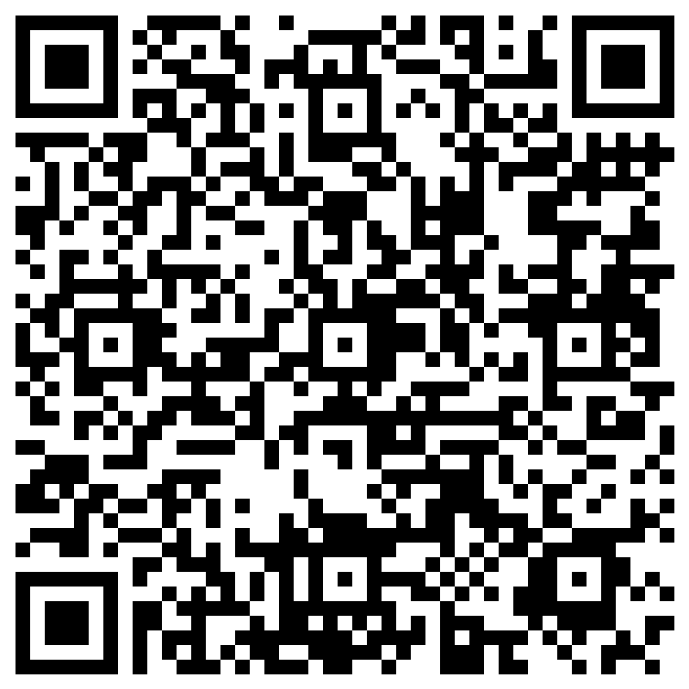
Attendance

Slide 5
Outline
Introduce IPUMS
IPUMS Demo. Extracting ACS Data
Introduce Data.Census.Gov
Data.Census.Gov Demo. Extracting ACS Data
Data.Census.Gov Workshop Exercise.
Differences between IPUMS and Data.Census.Gov

Slide 6
IPUMS
IPUMS USA collects, preserves and harmonizes U.S. census data
Easy access and Documentation.
American Community Surveys (ACS) from 2000 to the present.
ACS measures the changing social and economic characteristics of the U.S. population(education, housing, jobs, etc)
Coding files to import data.

Slide 7
IPUMS Data Extraction Demo
Register to access data.
https://usa.ipums.org/usa-action/variables/group
Pick variables by from ‘Household’ or ‘Person’ menus.
Search by variable name.
‘Select Samples’ to pick years.
View Cart -> Submit Sample Selection
Example Search:
Household:
Technical - year, sample, serial, hhtype: Geography - region, statefip, countyfip: Economic characteristics - hhincome, rentm mortotal
Person:
Technical – pernum: Family interelate – sfrelate: Demographic - relate, sex, age: Education – educ: Income - inctotal, ftotalinc

Slide 8
Data.Census.Gov
https://data.census.gov/
Explore Tables:
Use filters to select Geography, Survey Name, Variables, ect.
Sample extract.
Topics: Health Insurance
Geography: All counties in New York.
Years: 2017
Survey: data from the Economic Census.

Slide 9
Exercise
Extract from https://data.census.gov/table
Search for following characteristics:
ACS 5 year estimate detailed table. Educational Attainment, School enrollment for all the counties in the state of New York from 2010-2015
Tutorials:
https://www.census.gov/data/what-is-data-census-gov/guidance-for-data-users/how-to-materials-for-using-data-census-gov.html

Slide 10
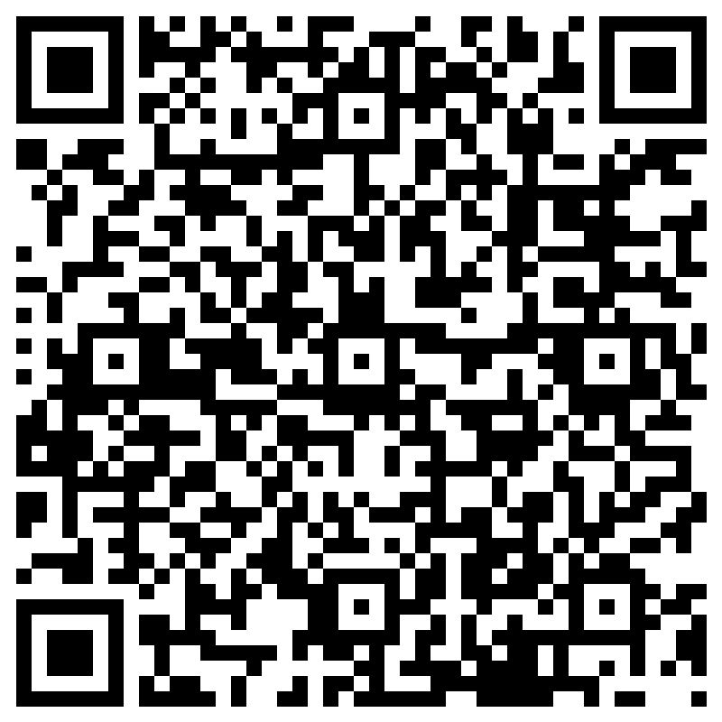
Evaluation

Slide 11
IPUMS
Data Census.Gov
raw data
Allows multiple years.
Code provided for importing data
Must register to use
Data Extraction Only
summary data
One year selection at a time
User must clean data them self
No account needed
Visual Elements and Data Extraction

Slide 12
CCSS Other Resources
Request for data
https://socialsciences.cornell.edu/research-support/request-data
Data Archive
https://archive.ciser.cornell.edu/

Slide 13
Sources
https://www.census.gov/content/dam/Census/library/publications/2020/acs/acs_general_handbook_2020_ch09.pdf
https://usa.ipums.org/usa/
https://www.census.gov/data/what-is-data-census-gov/guidance-for-data-users/how-to-materials-for-using-data-census-gov.html

